Slide 1
A JSON HTTP Notation for extending application servers with third-party services A case study enabling a virtual file system for the University Cloud Suite
Alessio Giordano
Relatore: prof. Simone Palazzo
Mercoledì, 13 Dicembre 2023

Slide 2
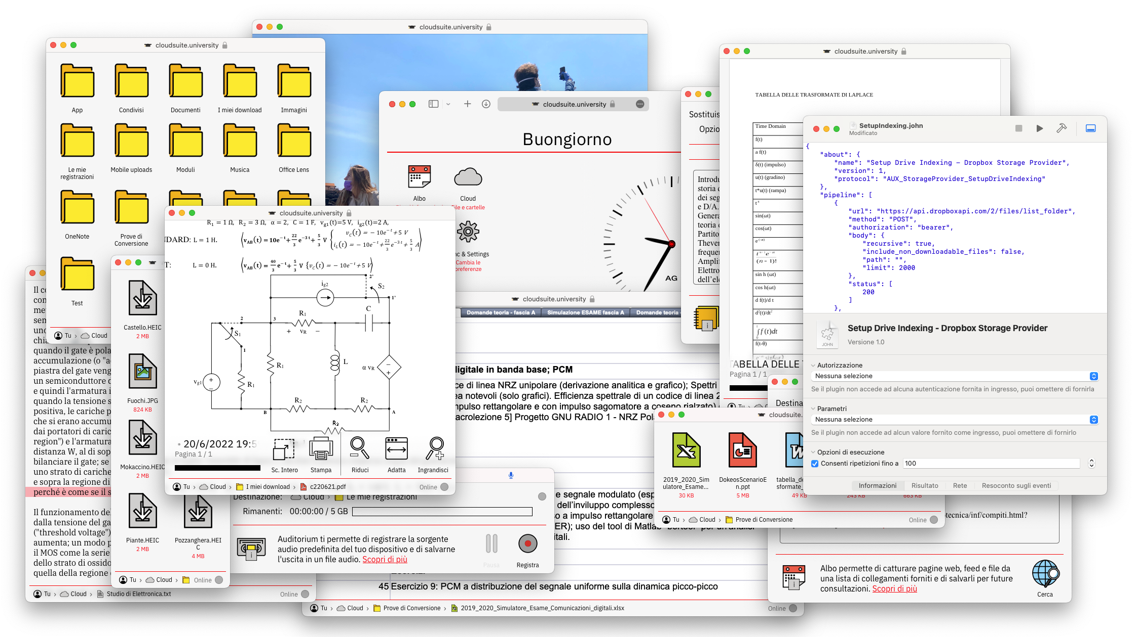
The University Cloud Suite
/
Obiettivi e Contenuti
37000 lines of source code and counting… Albo • Syllabus • Auditorium • Sync and Settings • Plugins • Storage • CodeViewer • MediaPlayer • PDFViewer • TextViewer • WebViewer • The Object Tree Traversal (OTT) The Auxiliary Toolkit TKAboutDialog • TKPlainButton • TKLinkButton • TKCheckmarkButton • TKCheckmarkGroup • TKClock • TKColumnScroll • TKDesktopView • TKDialogForm • TKDialogApp • TKPlainField • TKDottedField • TKFooter • TKPageHeader • TKSectionHeader • TKIconImage • TKIconButton • TKIconView • TKIconDesktop • TKIconBanner • TKIconGroup • TKIconBar • TKInfoDate • TKInfoEntry • TKInfoPanel • TKLocalizedNode • TKLocalizedString • TKMarqueeText • TKPageManager • TKPathComponent • TKPathBar • TKMenuItem • TKPopupMenu • TKProgressComponent • TKProgressBar • TKSeekBar • TKPulsingLoader • TKLineSeparator • TKThinSeparator • TKRegularSeparator • TKMediumSeparator • TKBoldSeparator • TKDottedSeparator • TKSpeaker • TKStatusBar • TKWebPage • TKWindowFullscreen • TKRootWindow • TKWindowLocation • TKPopupWindow • TKWindowButton • TKWindowState The JSON HTTP Notation (JOHN) JOHN+Options+Group • About • Assertion • Authorization • Body • Execution+Redirection • IOProtocol • IOPayload • IOMarkup+XML+HTML • Merger • Cookies • Parameters • Repetition • Result • Stage • Variable+Substitution • AnyResult • ExpectedResult • ExpectedValue • SettableValue • HTMLParser • Subscript+Element+Key+Index+Bound+Pattern • DebugDelegate • LoggerDelegate • JOHNEditor Converters for LibreOffice-Accepted File Formats (CLAFF) Office Open XML • OpenDocument • Pages • Numbers • Keynote • Rich Text Format • EPUB • DOC • XLS • PPT • CSV
The University Cloud Suite

Slide 3
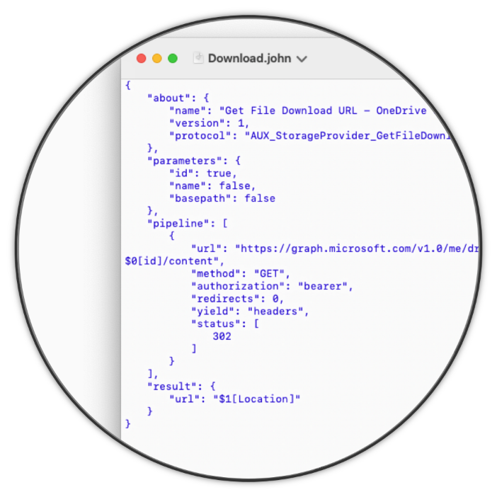
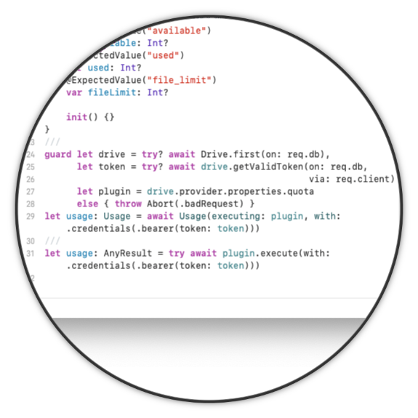
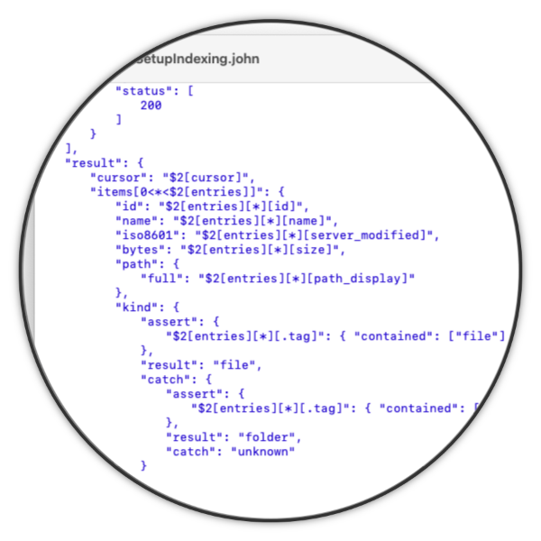



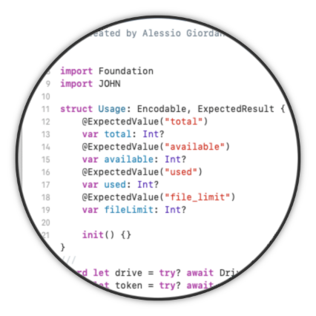
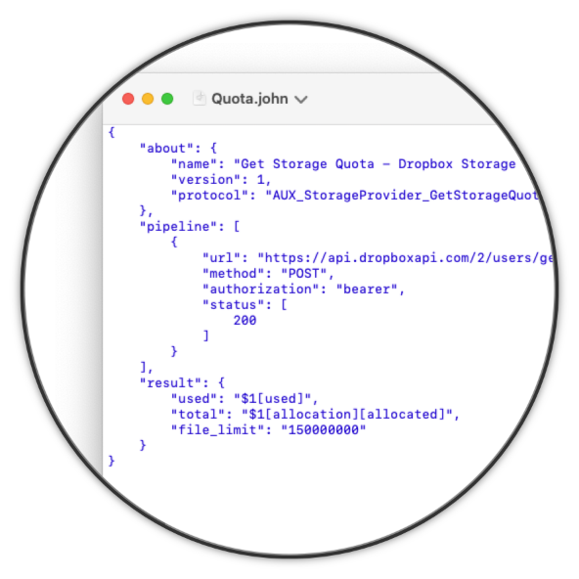
The JSON HTTP Notation
Risultati e Conclusioni
JOHN Language Specification
JOHN Runtime for Swift
JOHN Editor for macOS

